Slide 1

Professor Ahmed rabah
Project by:-
Prateek Arora

Slide 2
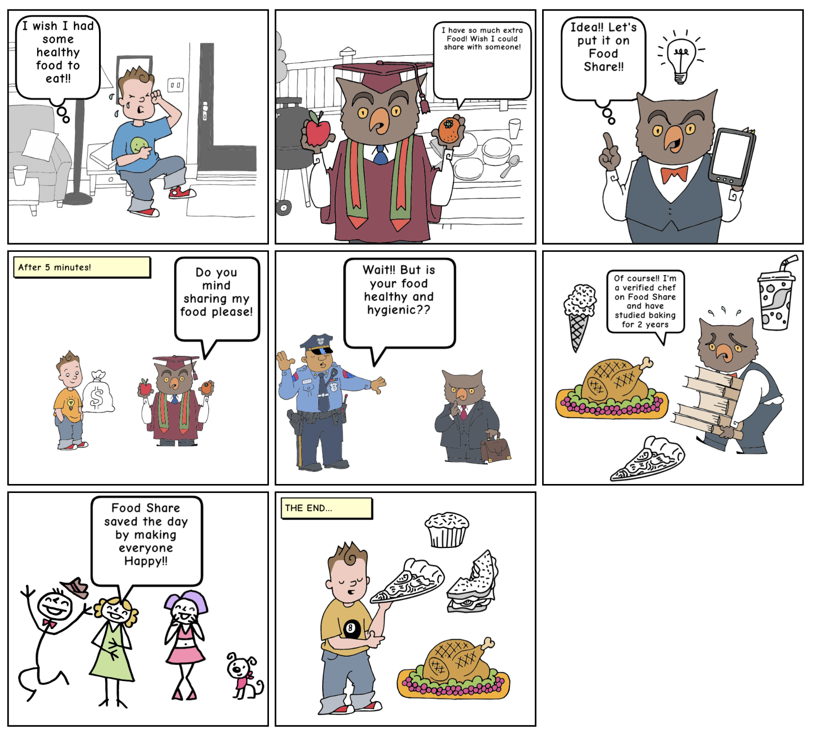

Storyboard

Slide 3
Existing Systems
UberEats
Uber Eats is a convenience food delivery service created by the founders of Uber.
AirBnb
AirBnb experiences :- Cooks sells their food or recipes online.
Experiences are excursions or other activities designed and led by local hosts. Hosts give guests unique access into places and communities in their city.
Foodler
Online food ordering service
Ranks restaurants according to customer feedback
Its gives a platform to connect restaurant to the customers via uber cabs.

Slide 4
Flaws
Improvements
There is no portal that connects cook to the customers.
Generating employment in a new market.
Controlling food wastage (Donation strategies)
Social networking. Food Enthusiasts and Cooking enthusiasts.
Not consolidated
AirBnB exp connect hosts to the customers
No food community
Only for restaurants
No home cooks
Similar to UberEATS
Connect restaurants)(not cook) to customers

Slide 5
Moonshots
Videos :- We implemented chef cooking videos in the link so that customer can see the cooking environment of the food.
Fundraisers :- We allow communities to come together and raise funds or meals via our application. Giving back to the community.
Personal/Public Feedbacks :- We allow customer and chefs to give personal and public feedbacks to each others. It helps to build trust between the stakeholders.
Food waste management :- Donation segment in our design can help food donation campaigns .

Slide 6
Product Objectives
Business Goals : - Creating a thriving food community platform and generating/empowering self sustainable employment.
Brand Identity :- Community of people eating and cooking healthy home-made authentic cuisines
Success Metric :- No of orders according to demographics, Active users/profiles and recurring/profile users. Suggestion according to location and personal preferences.

Slide 7
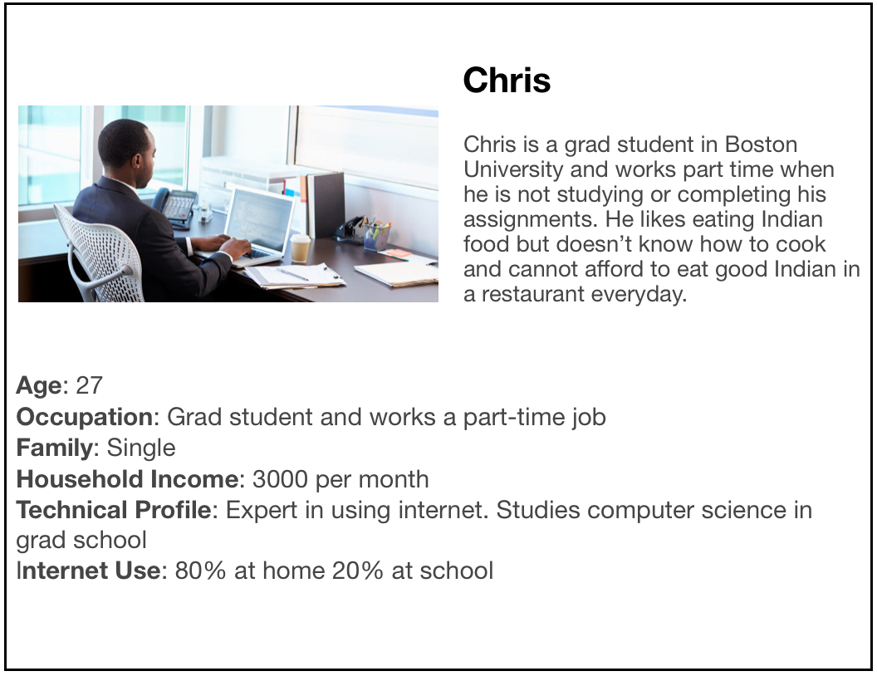
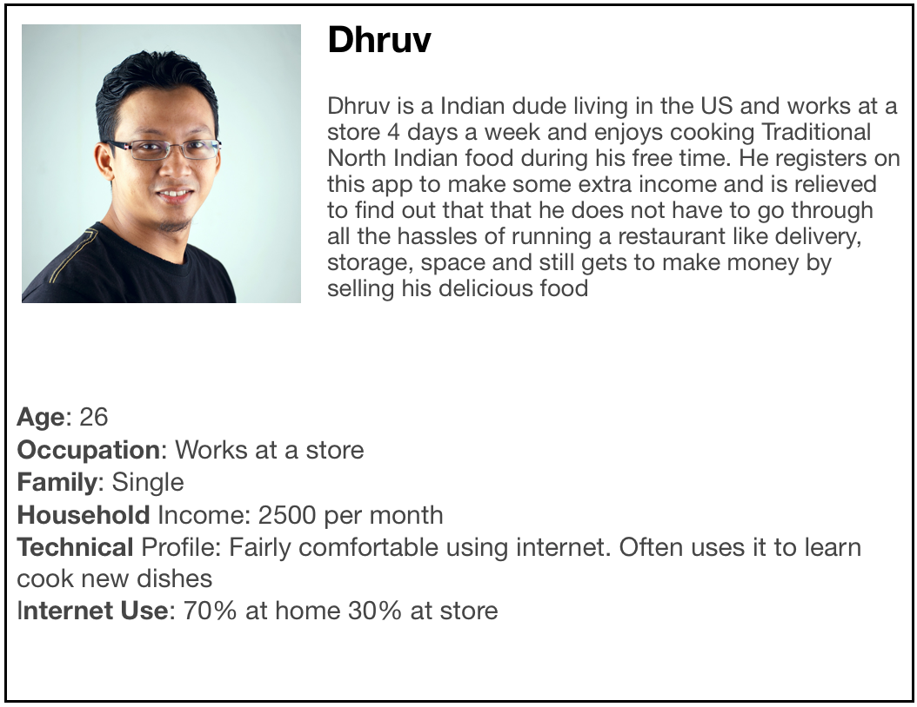
User Personas

Slide 8
Structural Plane
Conceptual Model
A) Chef/Cook
Either he can make a profile and sell food or market his food/recipes etc.
Chef order list– Add food / recipes.
B) User
Customer can order food from chefs trending food around.
Customer cart :- Customer order list
Customer can search food based on different cuisines

Slide 9
Application Objective
What are we trying to achieve:
Foodshare’s trying to provide affordable, healthy, authentic, quality controlled food to our customers. Our objective is to create more repeat customers and give a platforms for food enthusiasts to connect.
This system can also be used as an ordering system in the restaurants and can eliminate the need of a server
What are we not trying to achieve:
We are not creating a food delivery service.
We are not just any other food ordering platform which caters to big food companies but our specialty is food prepared by local skilled chefs

Slide 10
End to End Flow
User Flow
Chef flow
User starts on Homepage and signup/logs in
After logging in user will discover trending meals
From meal list page he can search for his preferred meal and order it
From the order list page the user checks out and completes the purchase
Chef starts on homepage and signs up/ login
After logging in the chef will be able to look at this profile/past orders
Chef can edit his meal recipes and photos
Chef can access his current order list and see who has ordered his food

Slide 11
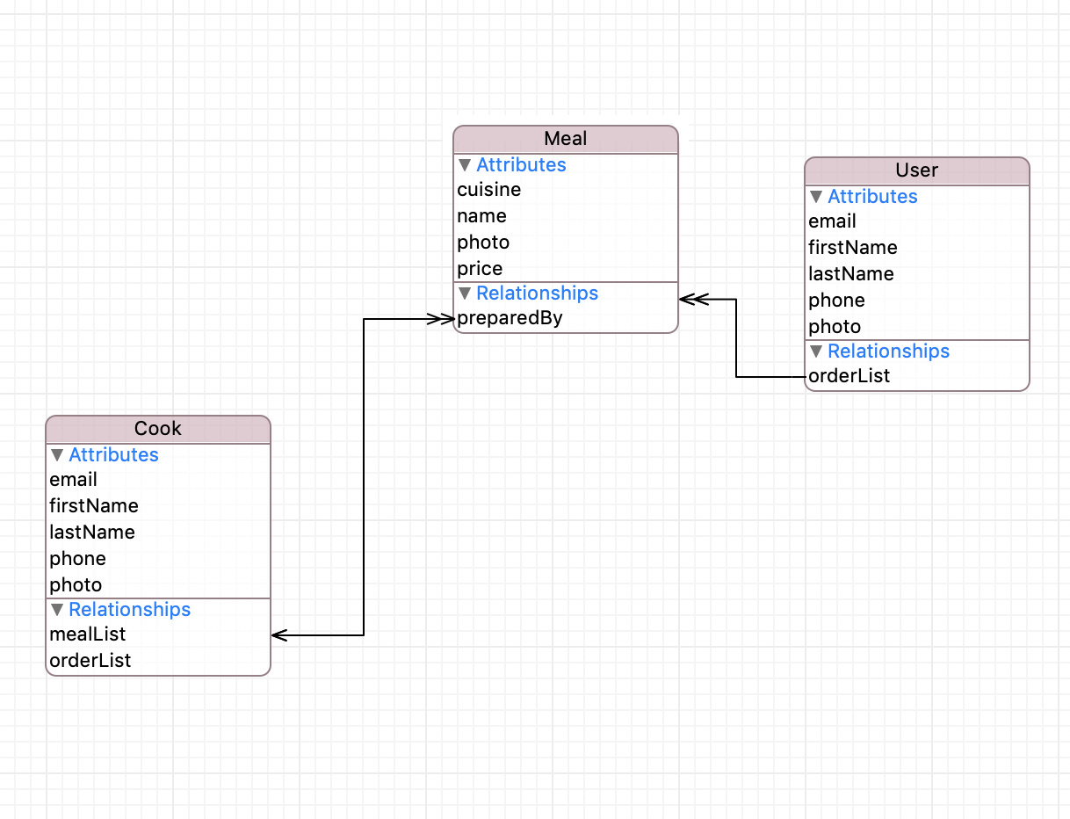
Data Model

Slide 12
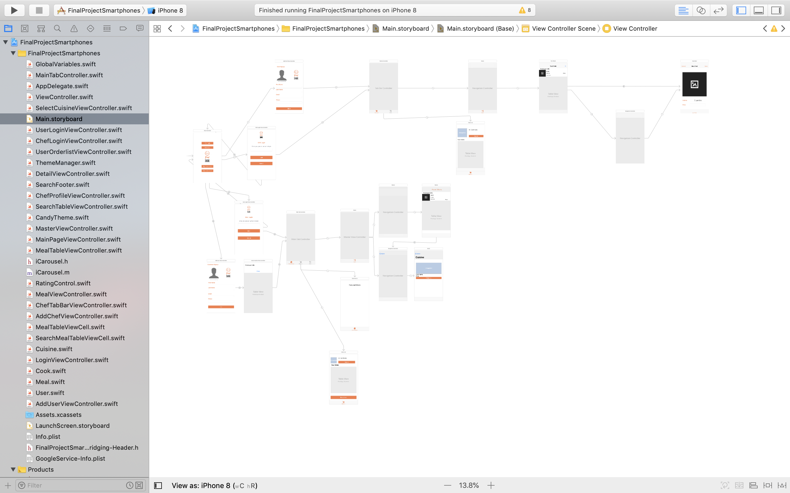
Main storyboard and file structure

Slide 13
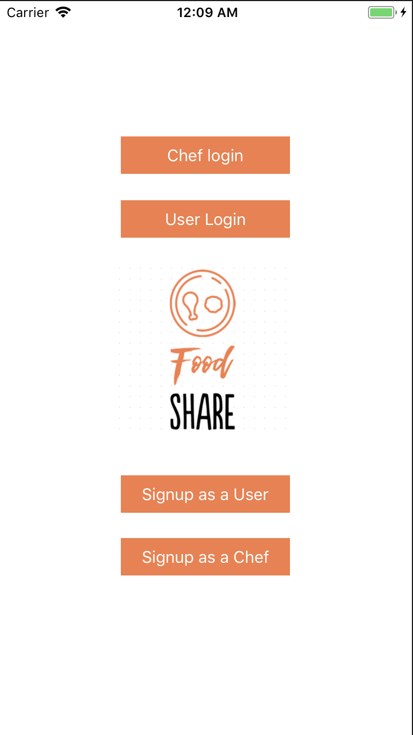
Home Page

Slide 14
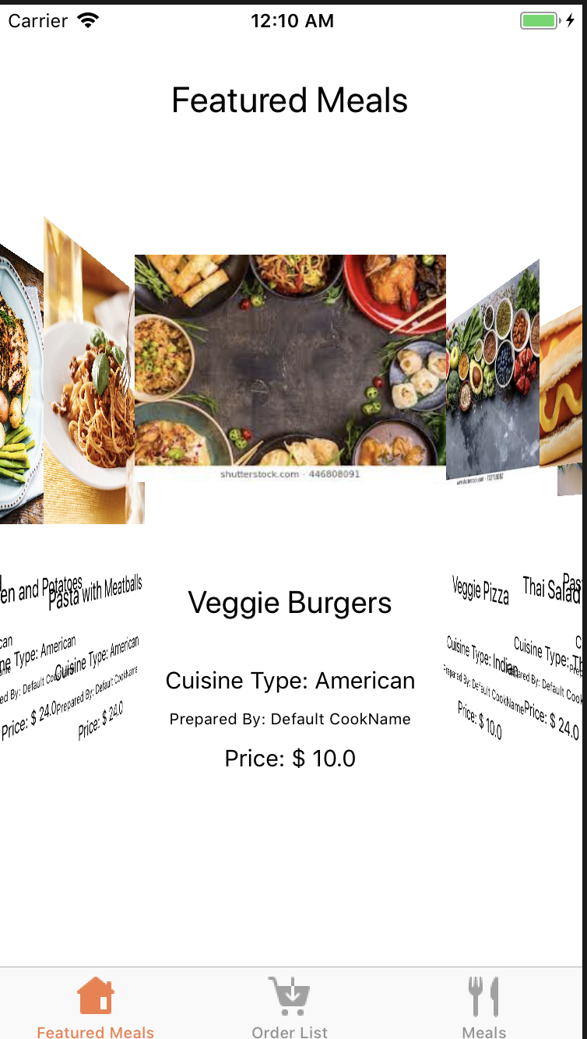
Some cool features of Food Share
Carousel view of featured meals
Used by chefs to promote their meals to customers (Paid)
Library Used: iCarousel

Slide 15
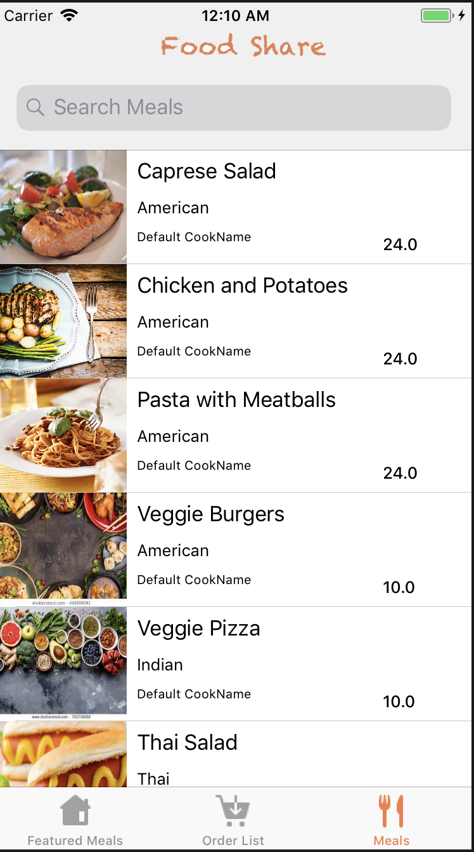
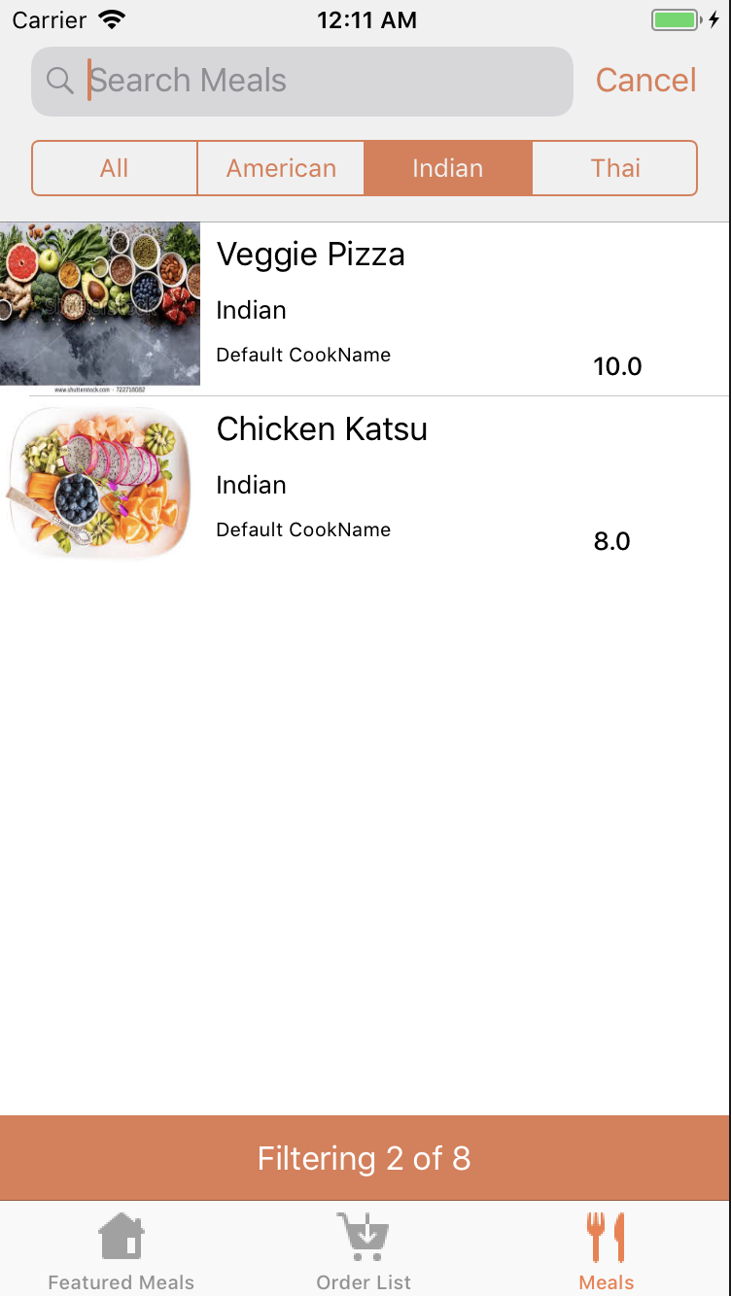
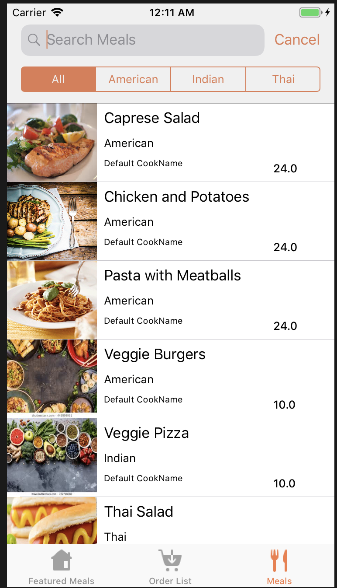
Fancy cuisine based meal search at user side

Slide 16
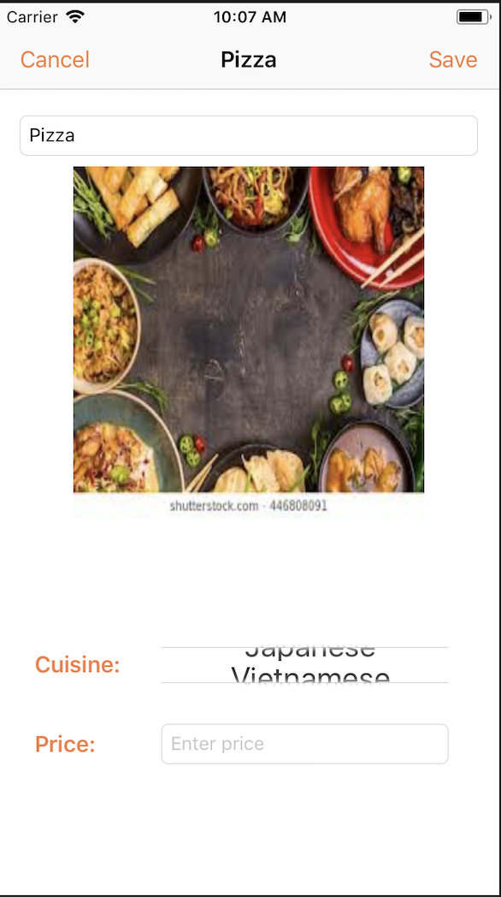
Cuisine Picker (Chef side)
Picker view used for cuisine selection

Slide 17
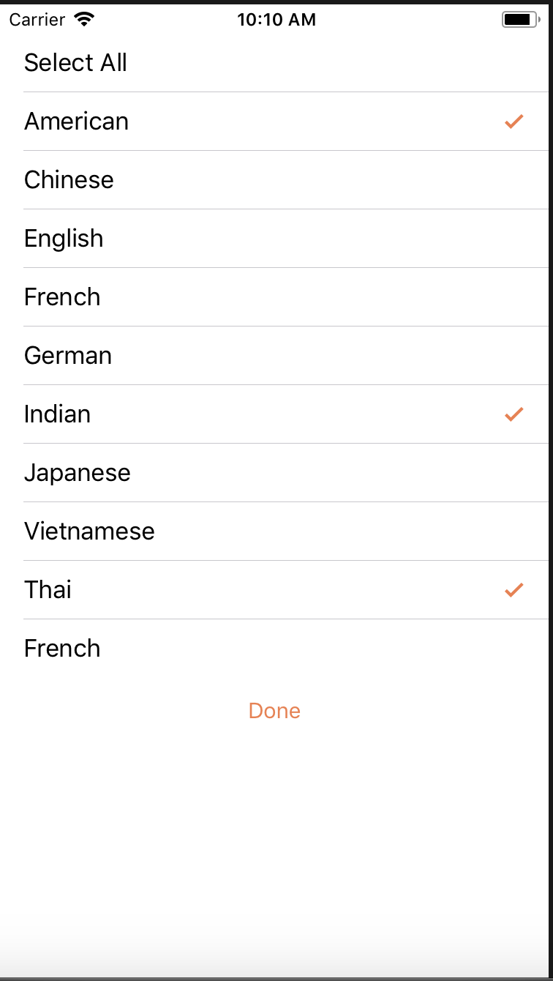
Cuisine Picker (User side)
Custom cuisine picker created to select multiple cuisine preferences of a user

Slide 18
Improvements in the near future
Location based segmentation
Fundraiser campaign integration
Evolving Food share into a community based social network
Better chef profile views and cooking environment transparency by including kitchen videos in chef profile
Chef quality control and brand identity development
Integration of a weekly/monthly meal plan system
Development of a cook based UI along with the existing cuisine/meal based

Slide 19
Thank You

